Slide 1

FOOD ORDERING SYSTEM (MINI PROJECT)
NARAYAN MAITY
EMP ID: 46117530
MENTOR:
DEVANGANA MANDAL
TRAINER:
AJAY KUMAR NERUMATI

Slide 2

TABLE OF CONTENTS
OBJECTIVE
ABSTRACT
SYSTEM AND TECHNOLOGY REQUIREMENTS
ENTITY RELATIONSHIP DIAGRAM
TABLE CREATION
IMPLEMENTATION
EXECUTION
TESTING
SUMMARY

Slide 3

OBJECTIVE
Designing the database, developing the queries and basic reports required for Food Ordering System.

Slide 4
ABSTRACT
This database is used as Food Ordering System. Also some basic reports have to be developed. Since this database is to be used by front end systems, it also requires some backend query and procedure designing.

Slide 5
SYSTEM AND TECHNOLOGY REQUIREMENTS
Physical Memory (RAM) - 1GB Minimum
Virtual Memory - Double the amount of RAM
Disk space - Total 5 GB
Processor - 550 MHz minimum
Video Adapter - 256 colors
ORACLE 11G - EXPRESS EDITION

Slide 6

DESIGN

Slide 7
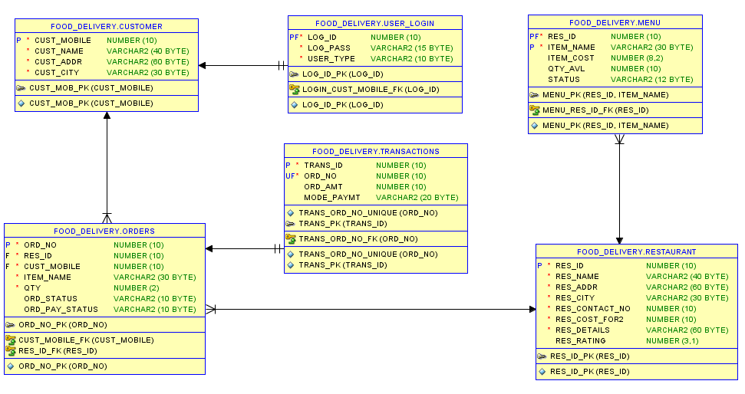
Entity Relationship Diagram

Slide 8
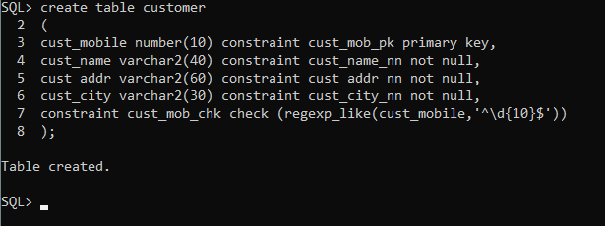
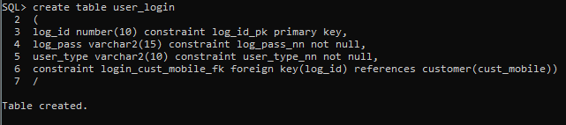
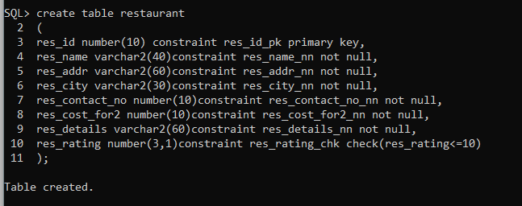
TABLE CREATION
CUSTOMER TABLE
USER LOGIN TABLE
RESTAURANT TABLE

Slide 9
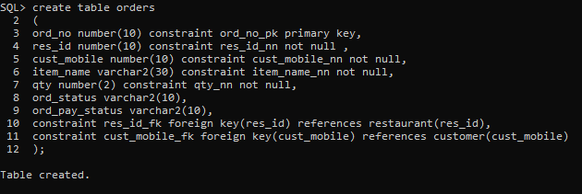
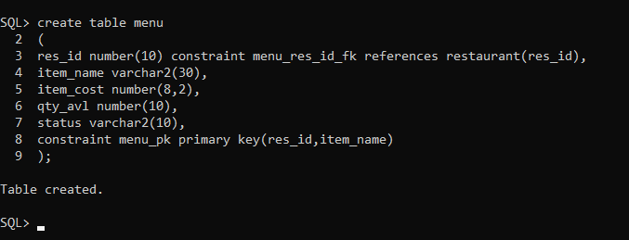
TABLE CREATION (CONTD.)
ORDERS TABLE
MENU TABLE

Slide 10
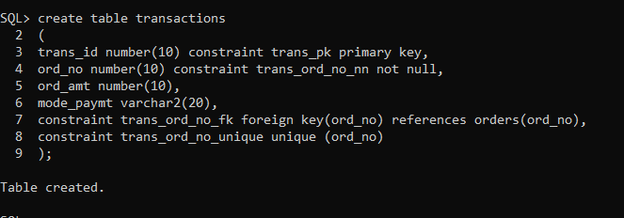
TABLE CREATION (CONTD.)
TRANSACTIONS TABLE

Slide 11

IMPLEMENTATION

Slide 12
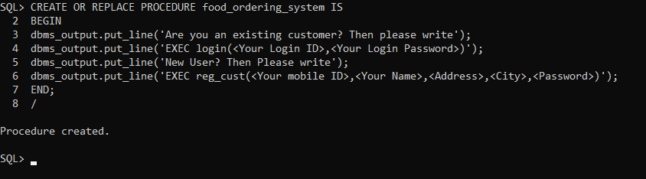
IMPLEMENTATION
PROCEDURE TO START FOOD ORDERING SYSTEM

Slide 13
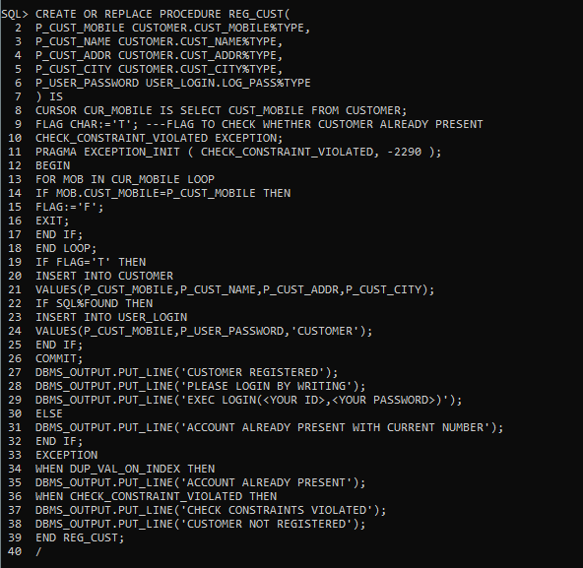
IMPLEMENTATION(CONTD.)
PROCEDURE TO REGISTER NEW USER

Slide 14
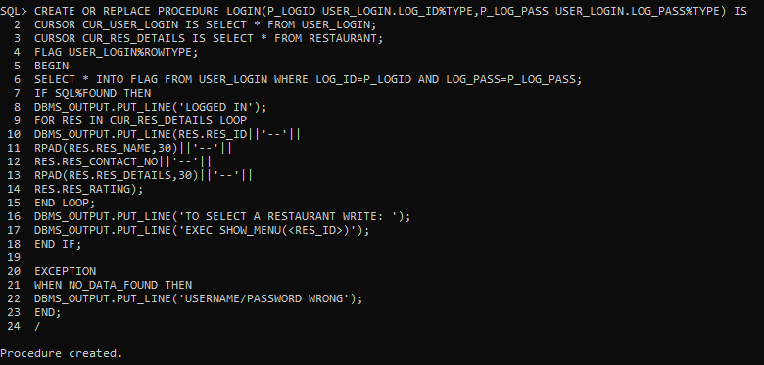
IMPLEMENTATION(CONTD.)
PROCEDURE TO LOGIN

Slide 15
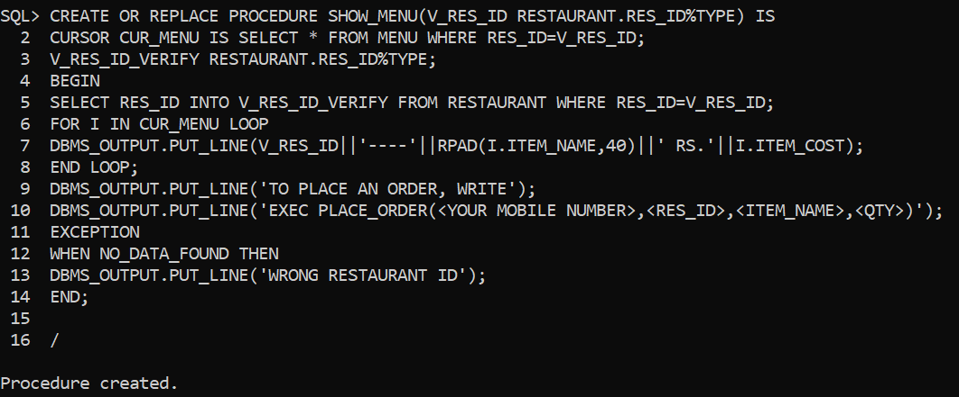
IMPLEMENTATION(CONTD.)
PROCEDURE TO SHOW MENU

Slide 16
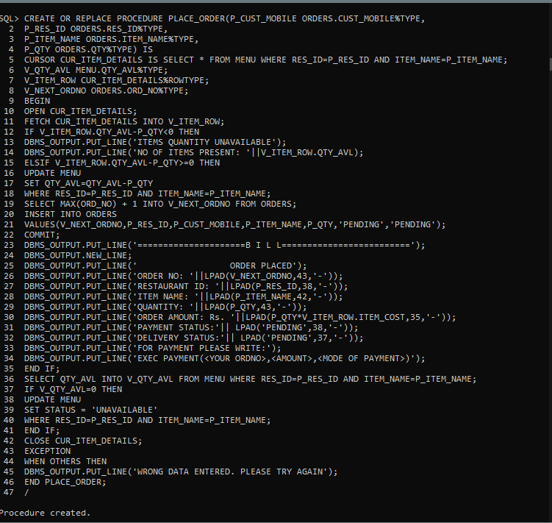
IMPLEMENTATION(CONTD.)
PROCEDURE TO PLACE ORDER
AND GENERATE BILL

Slide 17
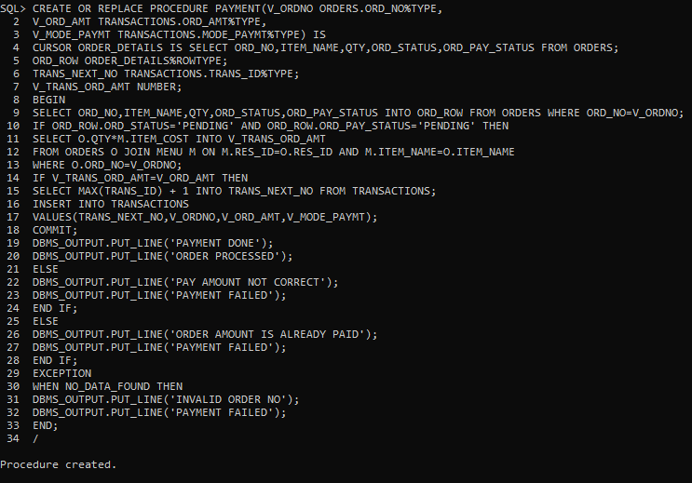
IMPLEMENTATION(CONTD.)
PROCEDURE TO
MAKE PAYMENT

Slide 18
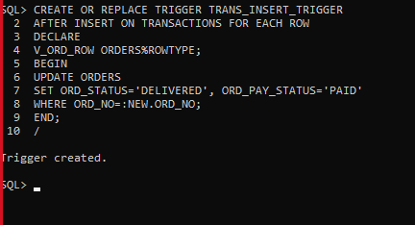
IMPLEMENTATION(CONTD.)
TRIGGER TO UPDATE
PAYMENT AND DELIVERY STATUS

Slide 19

EXECUTION

Slide 20
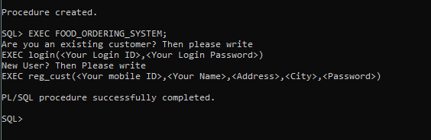
EXECUTION
STARTING THE FOOD ORDERING SYSTEM

Slide 21
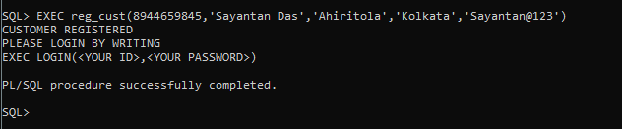
EXECUTION(CONTD.)
REGISTERING A NEW CUSTOMER

Slide 22
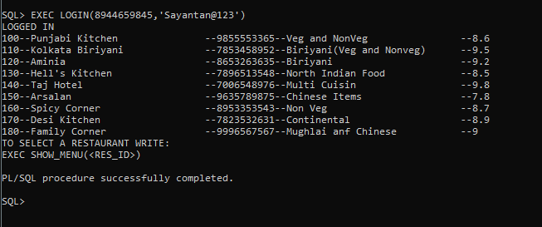
EXECUTION (CONTD.)
LOGGING IN AND DISPLAYING RESTAURANTS

Slide 23
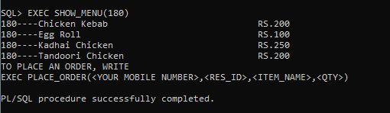
EXECUTION (CONTD.)
SHOW MENU OF THE CHOSEN RESTAURANT

Slide 24
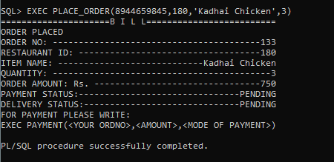
EXECUTION (CONTD.)
ORDER PLACEMENT AND BILL GENERATION

Slide 25
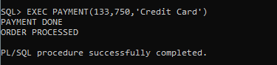
EXECUTION (CONTD.)
PAYMENT FOR ORDER

Slide 26

TESTING

Slide 27

TESTING
How testing is performed?
By examining the user requirements
By providing invalid/wrong details in various procedures
By examining the functionalities

Slide 28
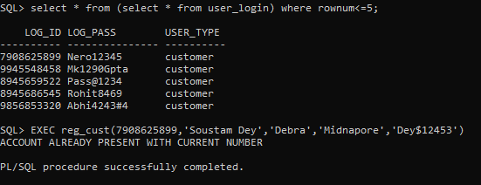
TESTING (CONTD.)
Test-1: Registering a customer with a mobile number that is already registered

Slide 29
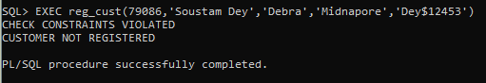
TESTING (CONTD.)
Test-2: Registering a customer with an invalid mobile number

Slide 30
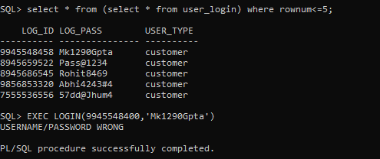
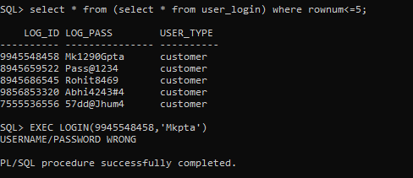
TESTING (CONTD.)
Test-3: Logging in
with unregistered number
Test-4: Logging in
with wrong password

Slide 31
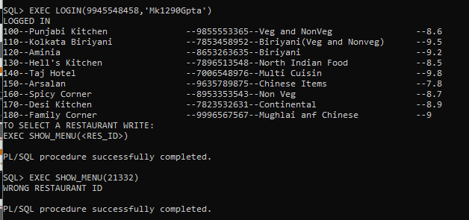
TESTING (CONTD.)
Test-5: Entering wrong Restaurant ID

Slide 32
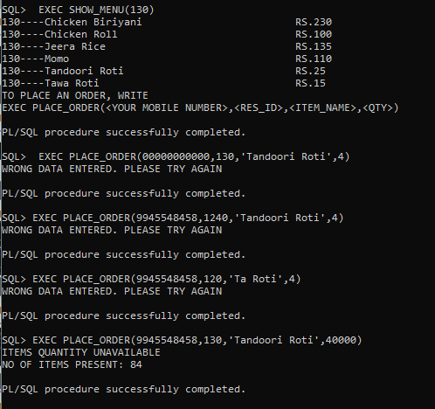
TESTING (CONTD.)
Test-6: Entering wrong details while placing order
Wrong phone number
Wrong Restaurant ID
Wrong Food Item name
Number of items ordered greater than available

Slide 33
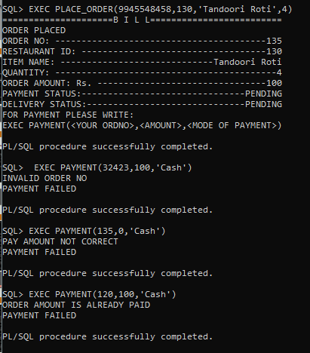
TESTING (CONTD.)
Test-7: Entering wrong details while payment
Wrong order number
Wrong amount
Paying for an order which has already been paid for

Slide 34
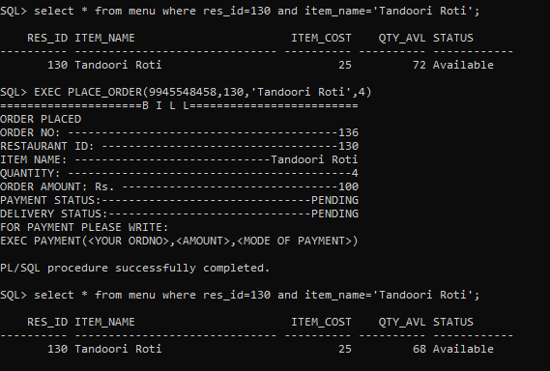
TESTING (CONTD.)
Test-8: Adjusting quantity available

Slide 35
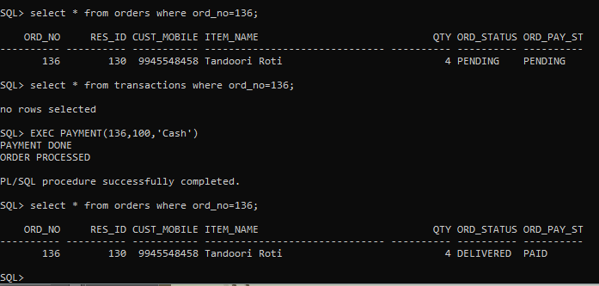
TESTING (CONTD.)
Test-9: Testing if Trigger works

Slide 36
SUMMARY
A DATABASE SYSTEM FOR FOOD ORDERING SYSTEM IS DESIGNED IN THIS PROJECT.
USING THIS SYSTEM AN USER CAN
Register himself/herself
Choose A restaurant from the list
Display the menu of a restaurant
Choose a food item and the quantity of food
Pay for the order
OTHER TASKS PERFORMED BY THE SYSTEM
Updates the available quantity of food item after an order is placed
Calculates the total bill
Updates the order and payment status after transaction is confirmed
Prevents unauthorised usage of the system
Handles possible exceptions

Slide 37


Thank You
Email
NARAYAN.MAITY@CAPGEMINI.COM

